Slide 1
The Great Divide of 1947

Slide 2
After the Second World War, Britain simply no longer had the resources with which to control its greatest imperial asset, and its exit from India was messy, hasty, and clumsily improvised
The partition of India remains a traumatic pain in the collective memory, of generations born after 1947 and indeed long after 1947.
Professor Ayesha Jalal has called Partition “the central historical event in twentieth century South Asia.”

Slide 3
Congress intellectuals and particularly Jawaharlal Nehru held the view that India as an historic and cultural entity had absorbed many outside forces and thereby grown richer, and, despite its apparent diversity , there had been an inner spirit in India which rolled through all ages. Like his father Motilal Nehru, Jawaharlal Nehru regarded the British parliamentary system as a model. On the other hand, Jinnah was determined to create a well-organized and broad-based political movement to face the Congress challenge.

Slide 4
The Muslim League accused the Congress government of being determined to destroy Muslim culture and impose Hindu culture and ideology on the helpless Muslim minority. The Muslim League organization categorically alleged Congress persecution of Muslims in the Congress-ruled provinces. The allegations were as follows:
Forcing of Muslim children to sing Bande Matram;
Offer revenges before Mahatma Gandhi’s portrait;
The prohibition of cow slaughter;
The elimination of Urdu and imposition of Hindi etc.( K.B. Sayeed, The Political System of Pakistan, 1967, Oxford, Page 36-37).

Slide 5
Choudhury Rahmat Ali suggested the word PAKISTAN in a Pamphlet published in January 1933. He pointed out that Pakistan was both Persian and an Urdu word and that he had composed it by taking certain letters from the names of Muslim homelands in India and Asia.
Pakistan =Punjab, Afghania( North-West Frontier Province/NWFP), Kashmir, Iran, Sindh, Turkistan, Afghanistan, and Baluchistan

Slide 6
Cabinet Mission Plan:
Cabinet Mission Plan: Three cabinet ministers including the secretary of state for India and Sir Stafford Cripps. The Cabinet Mission arrived in New Delhi on March 24, 1946 and held a series of discussions with Indian leaders regarding the future constitutional setup. But the differences between the Congress and the Muslim League could not be bridges. The Cabinet Mission announced their plan on May 16, 1946.They turned down the demand for a sovereign state of Pakistan as impracticable and unworkable.

Slide 7
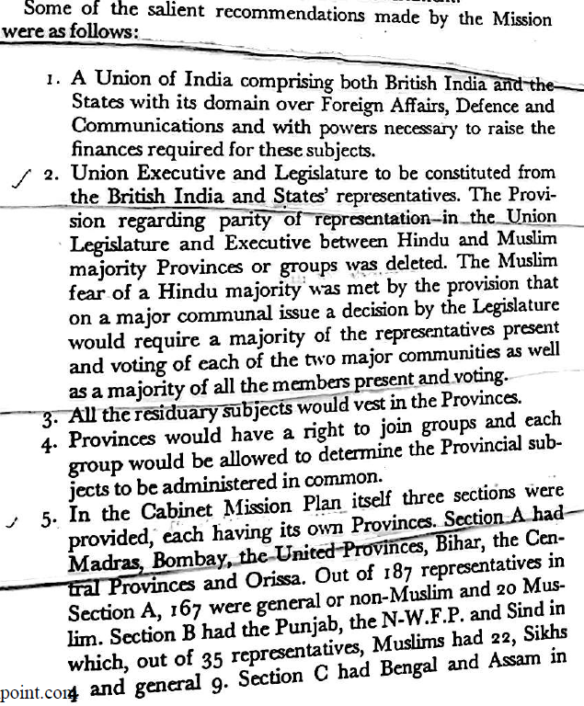
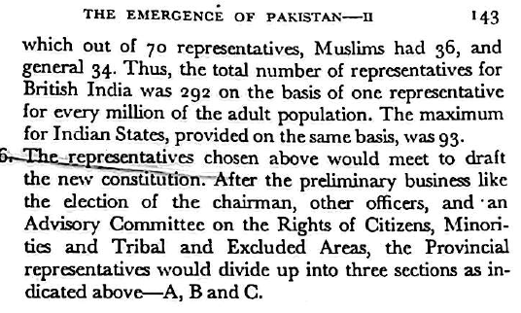
Proposals outlined in the Cabinet Mission Plan:

Slide 8
Reactions :
Even though the Cabinet Mission had rejected Pakistan, the Muslim League accepted the plan. The Muslim League thought that the battle for Pakistan could not be won immediately. The Cabinet Mission had offered the Muslim League a great tactical advantage in the form of compulsory grouping of the six Muslim provinces in Section B and C.

Slide 9
The Congress, on the other hand, was not happy regarding the compulsory grouping of provinces, but they were confident that it would not work.
Section A:Hindu majority provinces
Section B & C: Muslim majority provinces
Proposal to form an interim government to carry on the administration until a new constitution was framed.

Slide 10
Political Economy of Riots:
The riots of the 1940s were explosive by nature
The Muslim League called on Muslims throughout India to celebrate August 16,1946 as Direct Action Day. Calcutta riots took place on the Direct Action Day.
Noakhali riots and communal conflicts
Jinnah said that he was bidding good-bye to constitutional methods , pointing out that the British government , faced with the prospect of Congress launching a civil disobedience movement , had decided to appease the Congress.
Lord Mountbatten

Slide 11
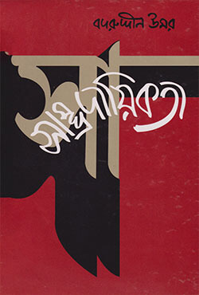
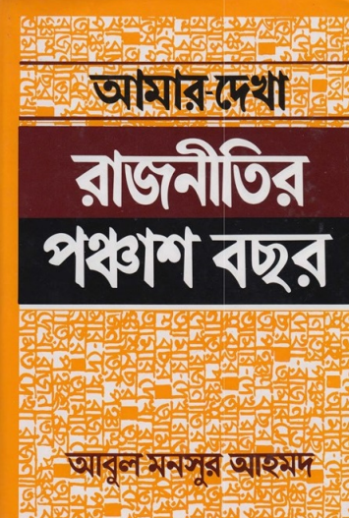

Slide 12
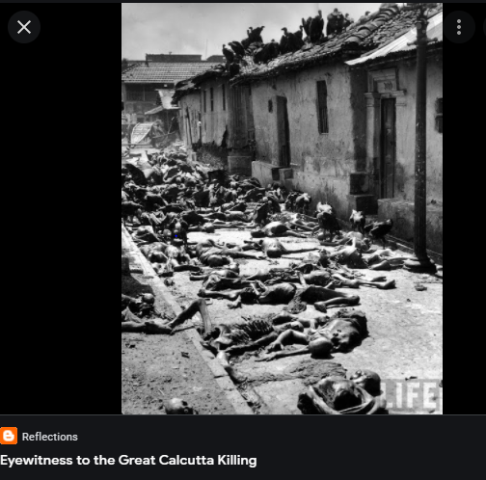


Slide 13
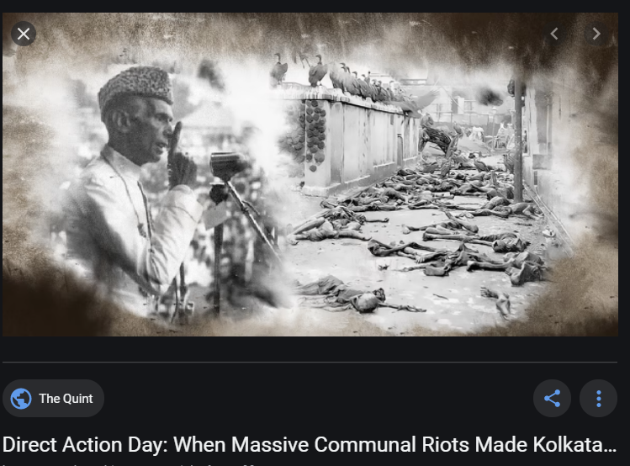

Slide 14
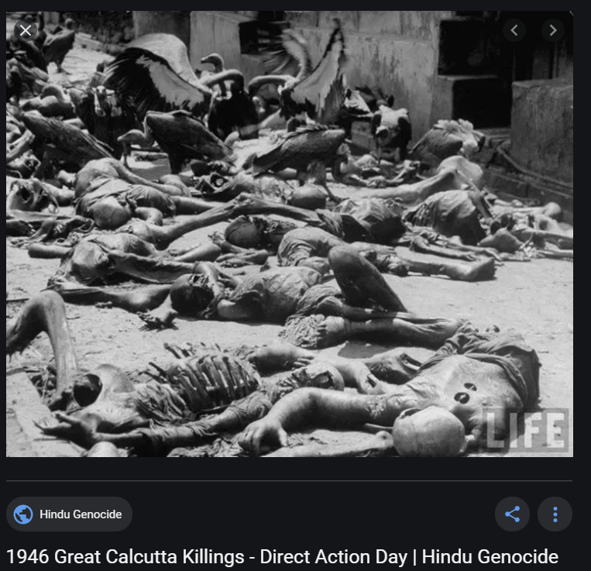

Slide 15
In the very first day, at least 5,000–6,000 people were murdered in Calcutta ( Anindita Ghoshal, page 26)

Slide 16
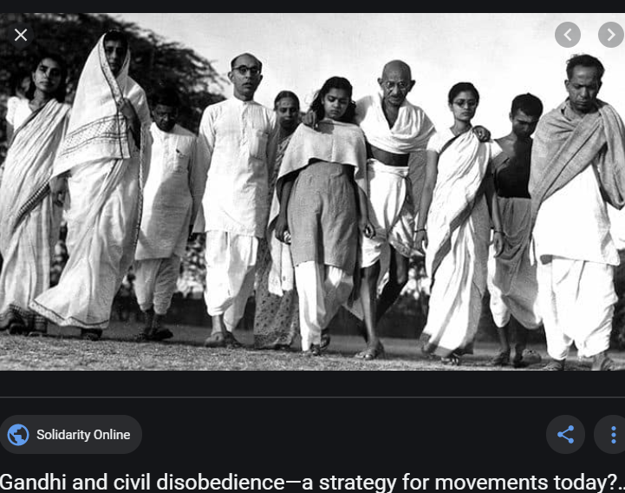

Slide 17
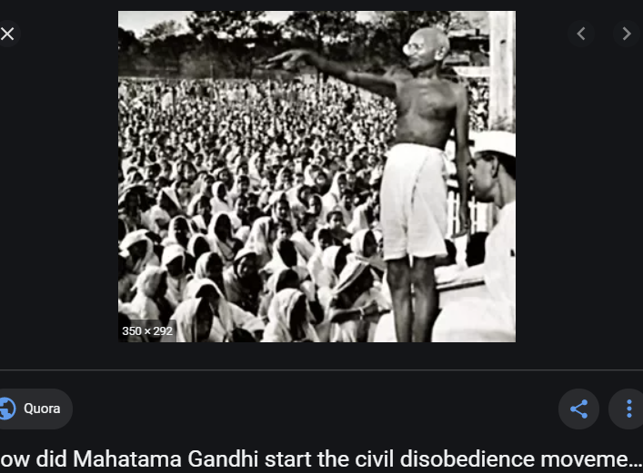

Slide 18
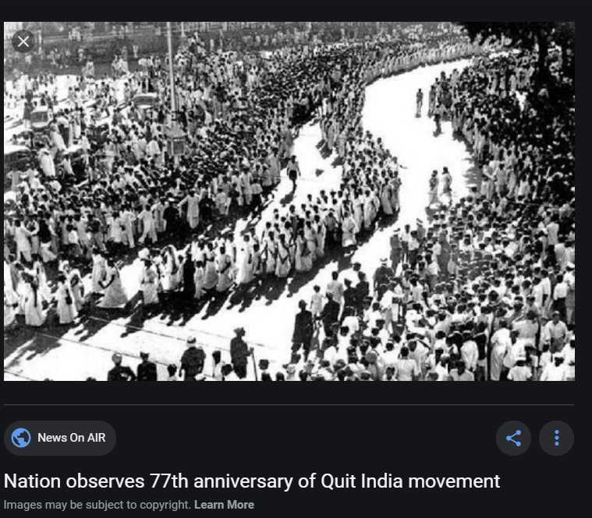

Slide 19
Indian Independence Act, 1947
The Indian Independence Act was passed in 1947. The act created two new independent dominions; India and Pakistan. Pakistan was split into Pakistan and East Pakistan which is now Bangladesh. The Bengal and Punjab provinces were partitioned between the two new countries. These dominions separated the Muslim, Hindu and Sikh population and caused the biggest forced migration which has ever happened that was not the result of war or famine. Lord Mountbatten continued as Governor-General and Jawaharlal Nehru was appointed India's first Prime Minister, Muhammad Ali Jinnah became Pakistan's Governor-General and Liaquat Ali Khan its Prime Minster.

Slide 20
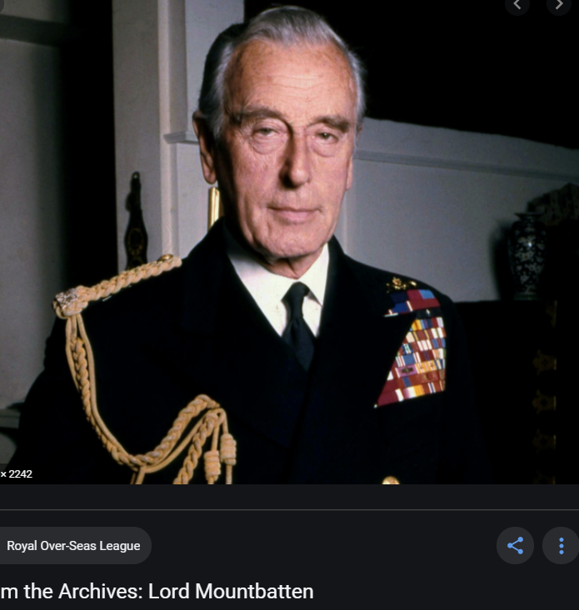

Slide 21
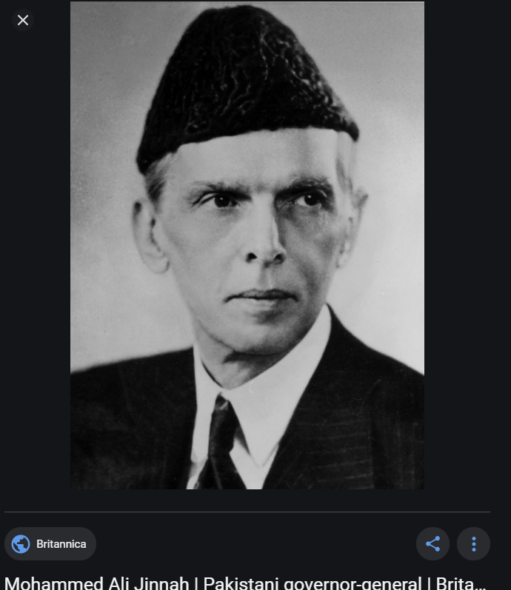

Slide 22
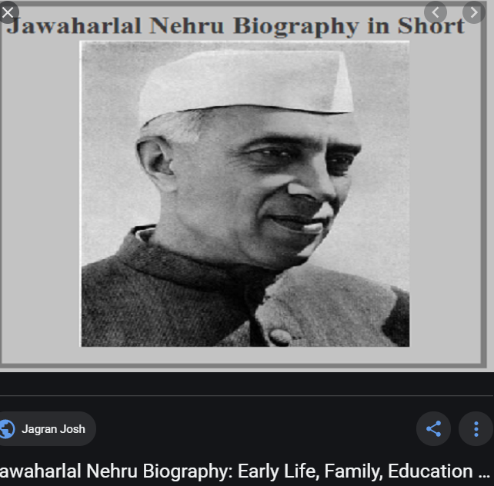
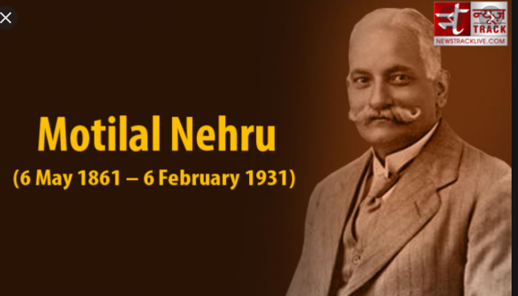

Slide 23
Features of the Indian Independence Act, 1947
Partition of the British India into two new and fully sovereign dominions-India and Pakistan with effect from August 15, 1947;
Division of the provinces of Bengal & Punjab among the two newly formed countries;
The offices of Governor-General in both the countries would be set up. These Governor-General would be representing the Crown;
The complete legislative authority would be conferred in the hands of the Constituent Assemblies of the two new countries;
The British rule over the princely states would be terminated from August 15, 1947;
Abolishing the use of title “Emperor of India” by the British monarch;
The Act includes the division of the armed forces between the two countries.

Slide 24
The second partition of Bengal, 1945-47
Since the Lahore Resolution of 1940, the demand for Pakistan, unspecific though it was from start to finish, had proved to be extremely useful from the British point of view.
The results of the elections of 1945-46, and the mandate given to the League by Muslim voters, made it impossible for London and Delhi to ignore Jinnah and the League in their negotiations at the center about the transfer of power
Quit India Movement
1947 Sylhet referendum: Karimganj subdivision remains in the India, the rest of Sylhet District joins the Pakistan

Slide 25
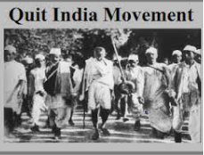
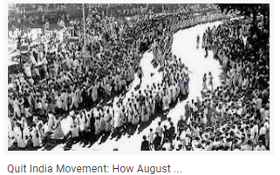
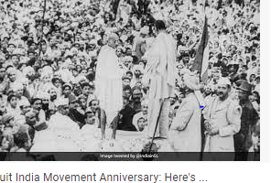

Slide 26
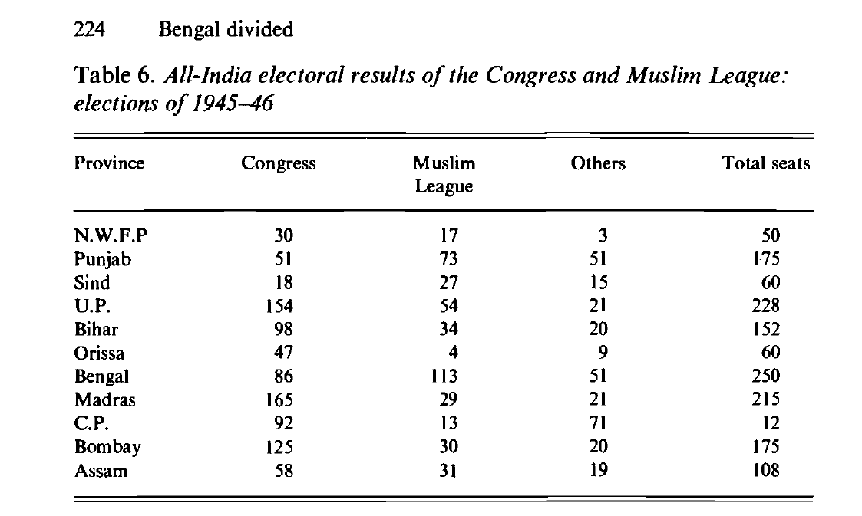

Slide 27
The partition campaign, 1946-47
In the last months of 1946 and early in 1947 these fears fuelled an organized and well-supported campaign among the Hindus for the partition of the province. The campaign for partition was inaugurated officially only in March 1947, when the Amrita Bazar Patrika announced that it was holding a poll to 'make a correct estimate of public opinion' on the question.
Establishment of the 'Bengal Partition League', the declared object of which was 'to demand a separate province in the district of West Bengal to safeguard the Hindu interest in West Bengal where they are in a majority'

Slide 28
Example of communal bitterness
The title of the pamphlet, 'Sangram', was a term borrowed from the nationalist vocabulary, except that now the 'struggle' was not against the British but against 'Muslim tyranny'. The British were now regarded as mere accomplices in Muslim crimes and the Governor and Viceroy took second place to Suhrawardy in the new demonology of Hindu communalists. In October 1946, for instance, a poster was prominently displayed on Rash Behari Avenue which declared:
We want the head of that dog Suhrawardy
We want the blood of the white skins!
(Kukur Suhrawardyr mundu chai, Sada chamrar rakta chai).
Source: Bengal Divided by Joya Chatterji.

Slide 29
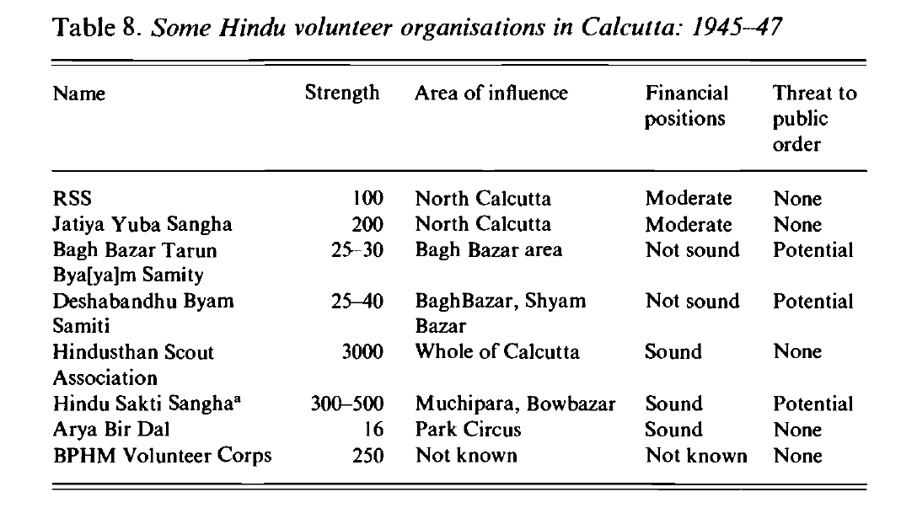

Slide 30
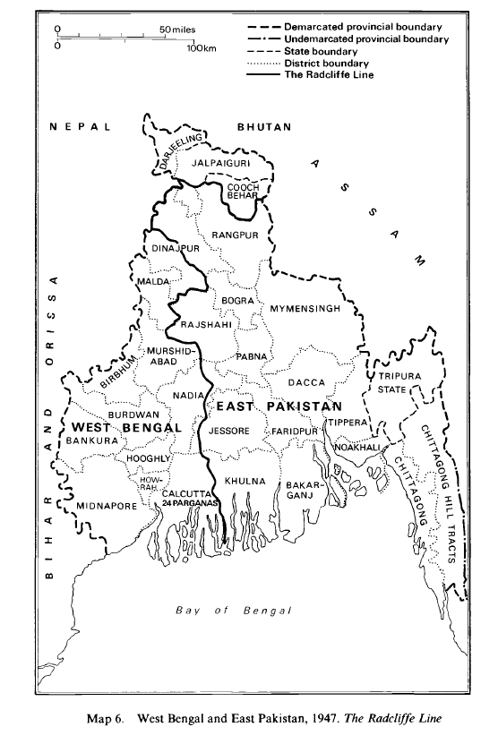
The Redcliff boundary line

Slide 31
The emergence of two nation-states out of one and making separate homelands for Hindus-Muslims, and their consequent displacement, resulted in a human tragedy of refugee-hood. Before the division, both the Hindus and Muslims dreamt of living in their own promised utopia, India or Pakistan. But within the utopia, the nation-seekers unfortunately did not plan anything concrete for them, especially on how to resettle and rehabilitate them properly. ( Anindita Ghoshal, page 37)

Slide 32
Suggested Books:
1. Abul Mansur Ahmed, Fifty Years of Politics as I saw It.
2. Anindita Ghoshal, Refugees, Borders and Identities: Rights and Habitat in East and Northeast India.
3. Joya Chatterji, Bengal Divided: Hindu Communalism and Partition, 1932–1947.
4. K. B. Sayeed, Pakistan : The Formative Phase, 1857—1948.
5. K. B. Sayeed, The Political System of Pakistan.

